Slide 1
STAT-515-MIDTERM PROJECT TEAM NUMBER-12
By,
Shameema Afrin Jahir Husain
Shwetha Srinivasan Natesan
Aniritha Tharun Krishanakanth

Slide 2
TITLE
Can you retire on $1 Million?
Here is How Long You Can Survive in Every state..

Slide 3
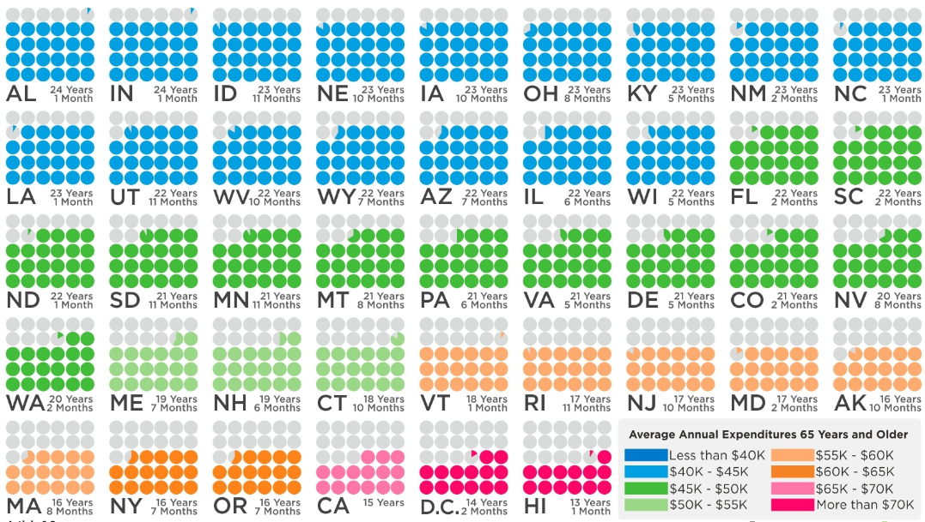
Original graph
Notes:
https://howmuch.net/articles/one-million-retirement-by-state

Slide 4
Purpose and moto
PURPOSE
Unique and interesting dataset to work on
Useful for all upcoming Millionaires sitting here
MOTO
To make it simpler and easy to understand for anyone watching this

Slide 5
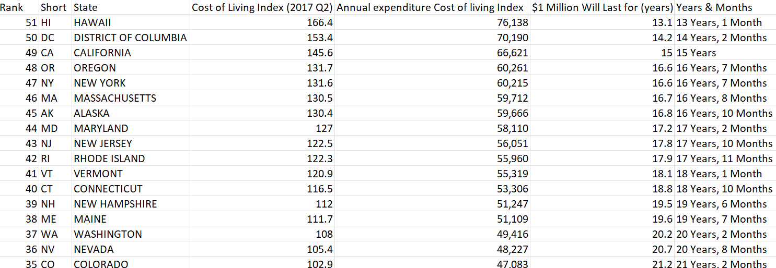
Snippet of our dataset

Slide 6
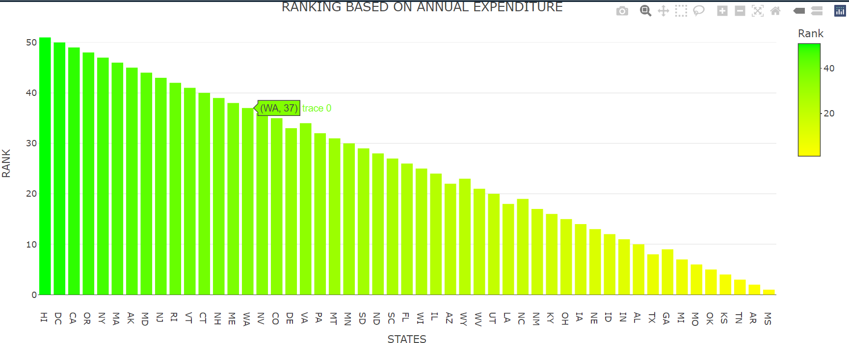
Bar graph-1

Slide 7
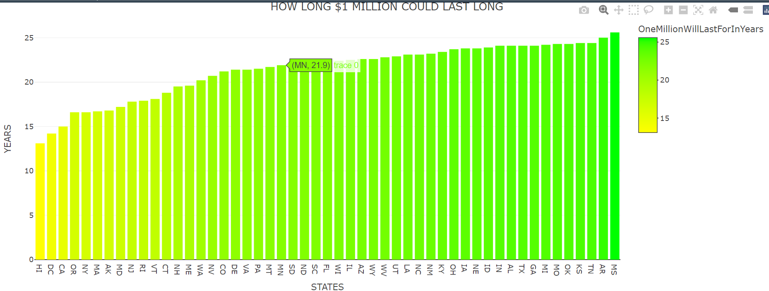
Bar graph-2

Slide 8
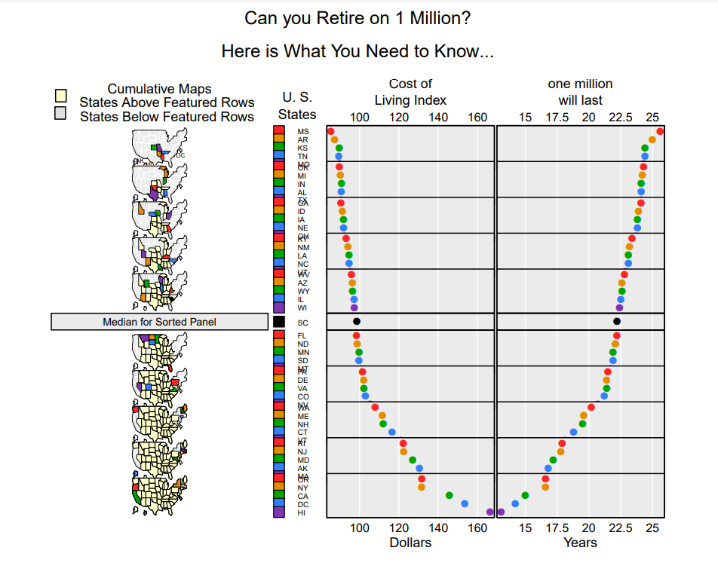
MICROMAP

Slide 9
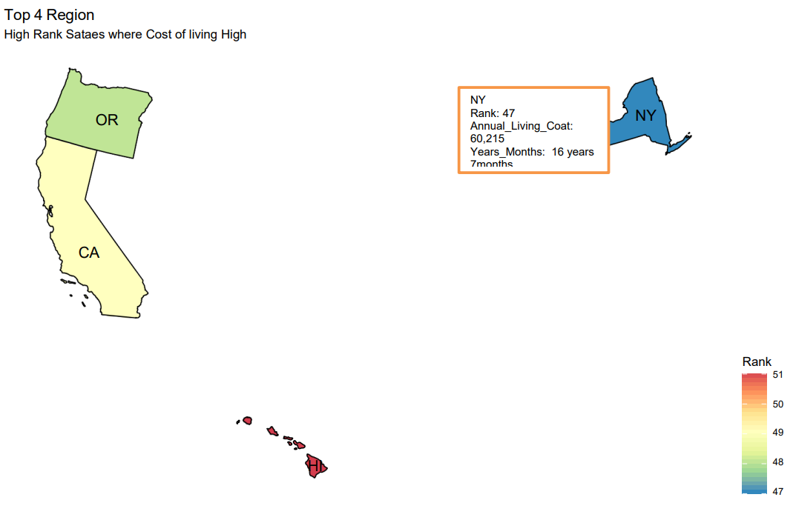
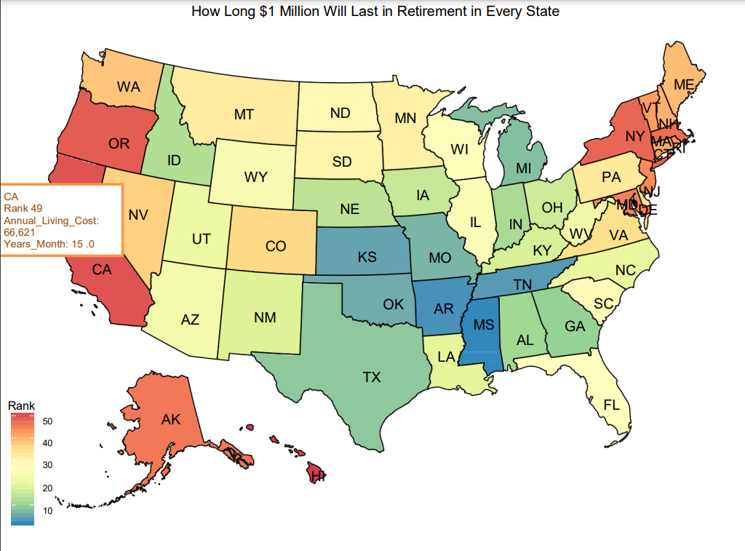
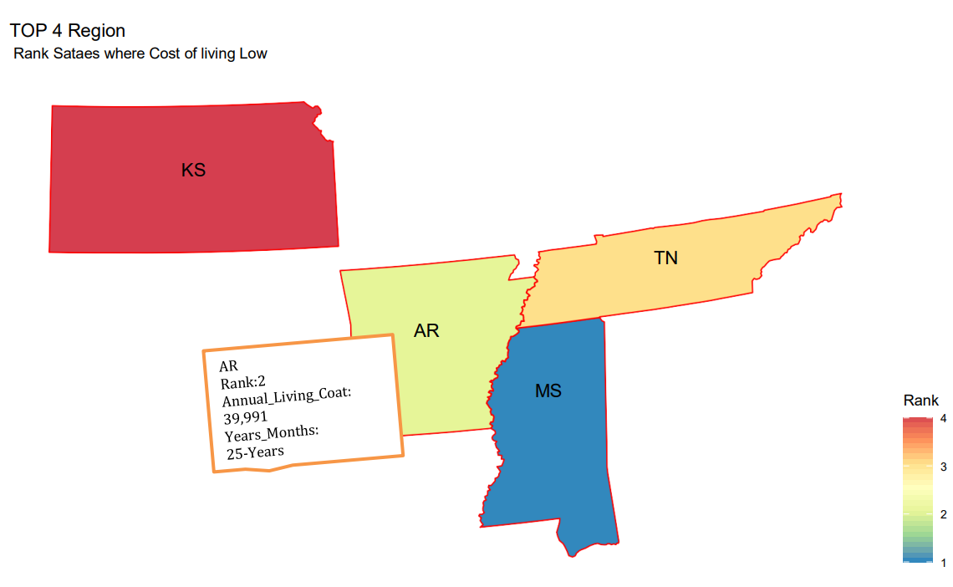
Plot

Slide 10
THANK YOU ☺

